Slide 1
NBA Player & Team Performance Analysis
By Ben Kessler, Tuukka Jaakkola, Jake Lamb, & Antonio Gutierrez

Slide 2
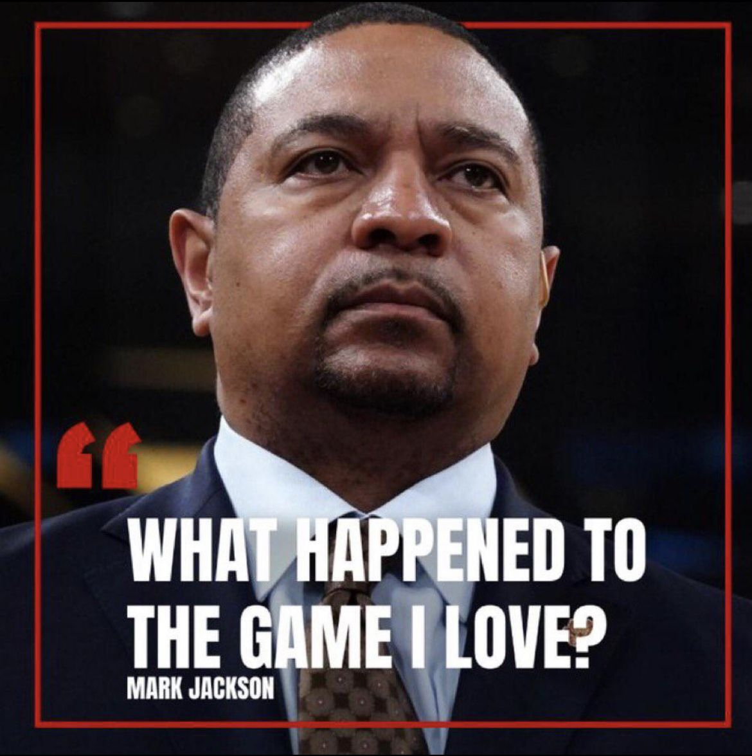

Slide 3
Hypothesis: Key Events Impact Performance
Birthdays
Home vs. Away
Cities of Interest

Slide 4
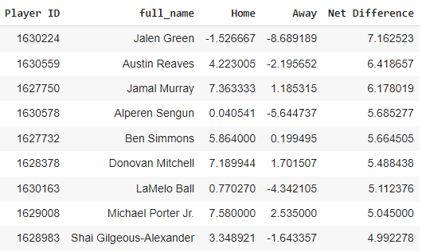
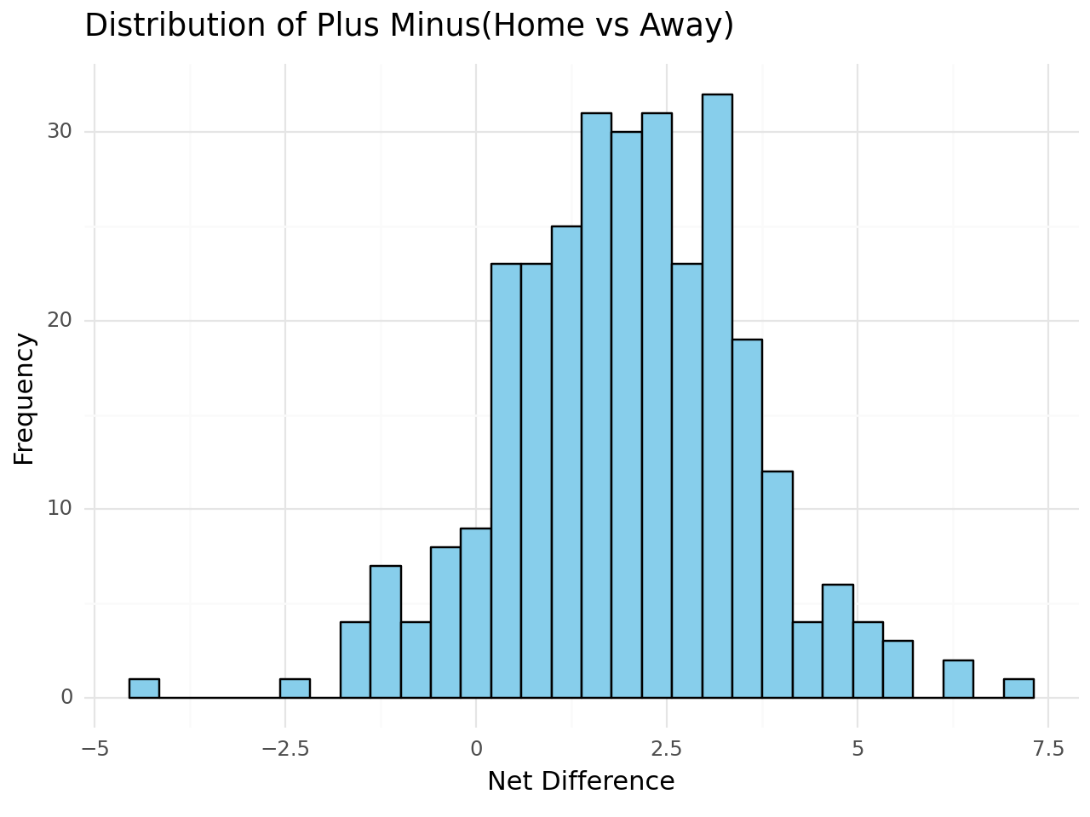
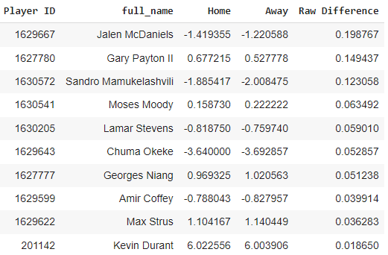
Highest Difference
100+ Game Minimum
Lowest Difference
Notes:
This captures variance of players

Slide 5
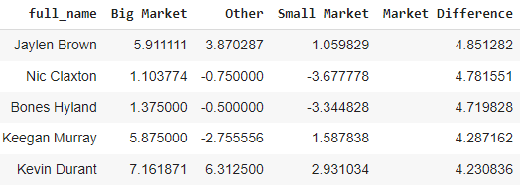
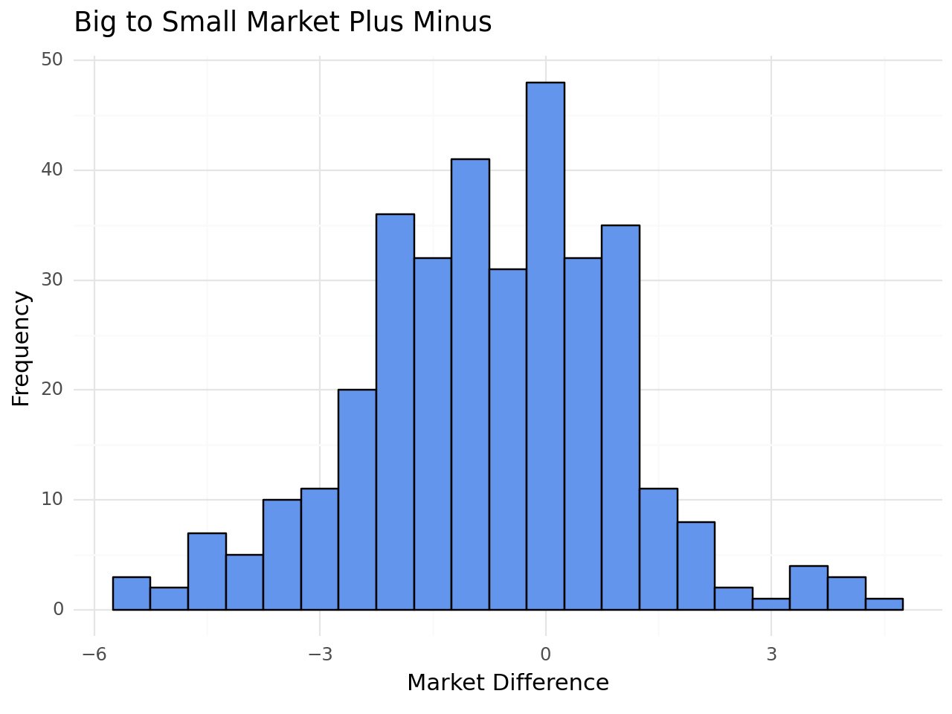
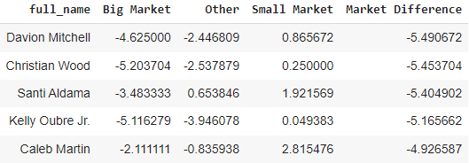
Play Better in Big Markets
100+ Game Minimum
Play Better in Small Markets

Slide 6
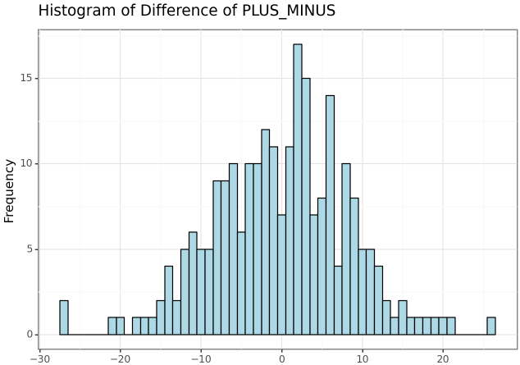
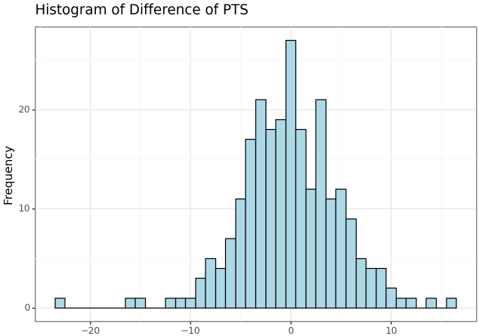
Data Dictionary:
Before Stats: Averaged game stats from the 45 days before birthday
After Stats: Averaged game stats for the 7 days after birthday
Difference = After Stats - Before Stats
2021-22 Fred VanVleet
2020-21 Draymond Green
2021-22 Steph Curry on 21 less min/game
Parameters:
Used Data from the 2017-18 season to current
Only included players that started at least 50 percent of the games they played in
2021-22 Kyrie Irving on 1 more min/game

Slide 7
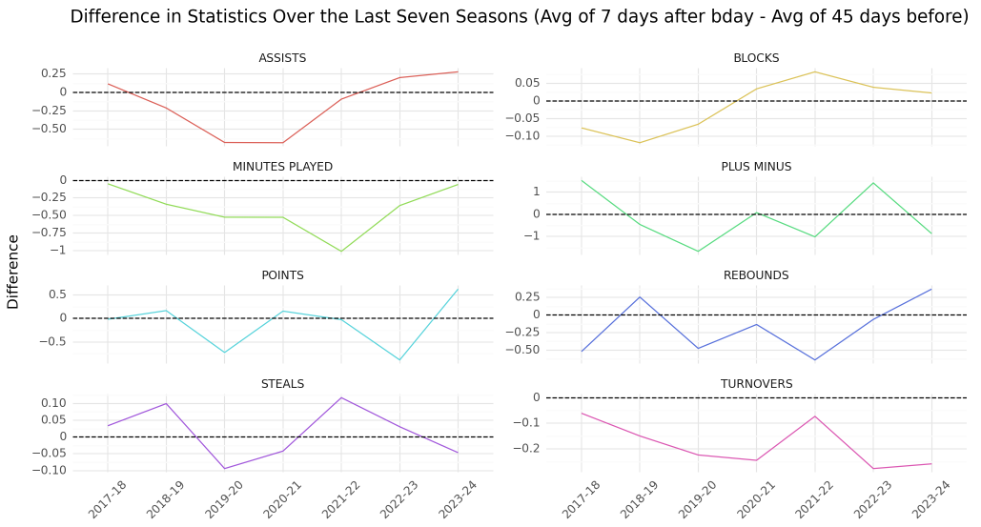

Slide 8
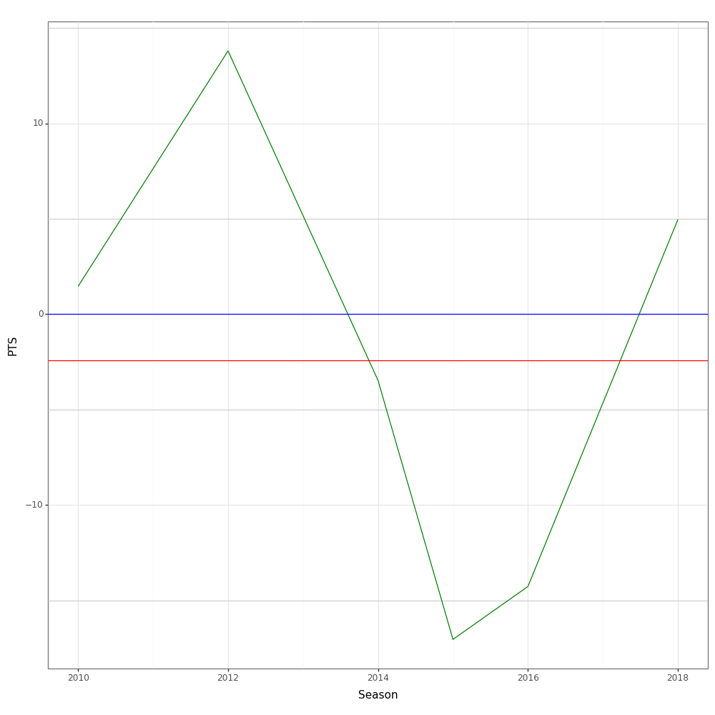
Season Avg - Post Birthday Game (Dwyane Wade)

Slide 9
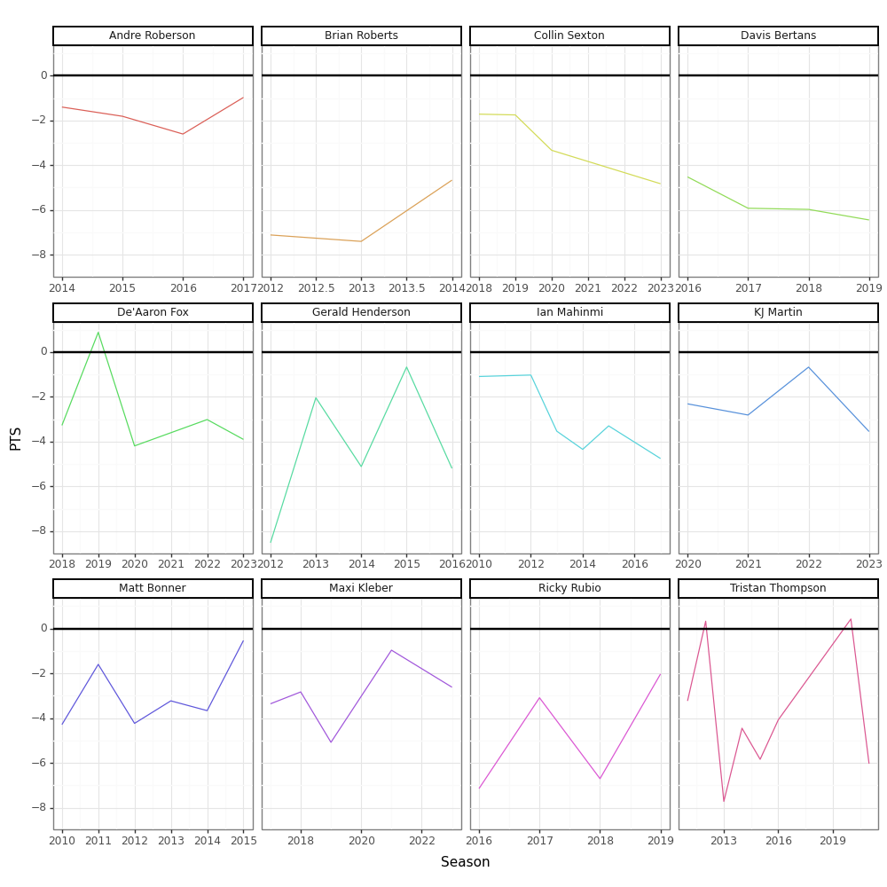
Rationale:
Data 2010-2023
Averaged games stats for the given season
Stats for the post birthday game
Difference = Birthday Game - Season Average
1-Sample T-Test
Mean: All players post birthday stats
Sample: Given players post birthday games (min = 3 seasons)
P-value < 0.05
Assumptions: Most players have no pattern
Note: Players who stand out from the other players

Slide 10
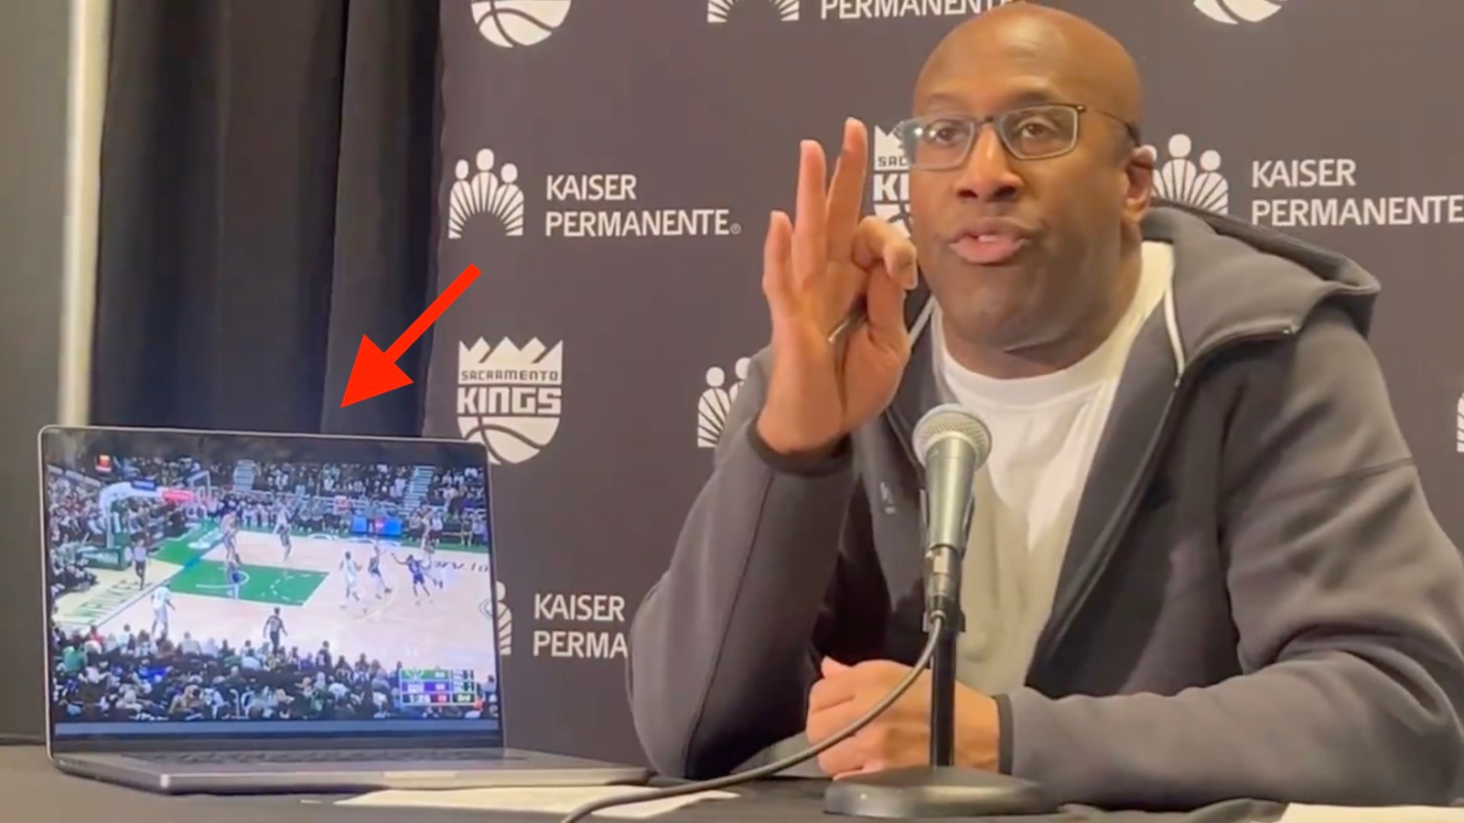
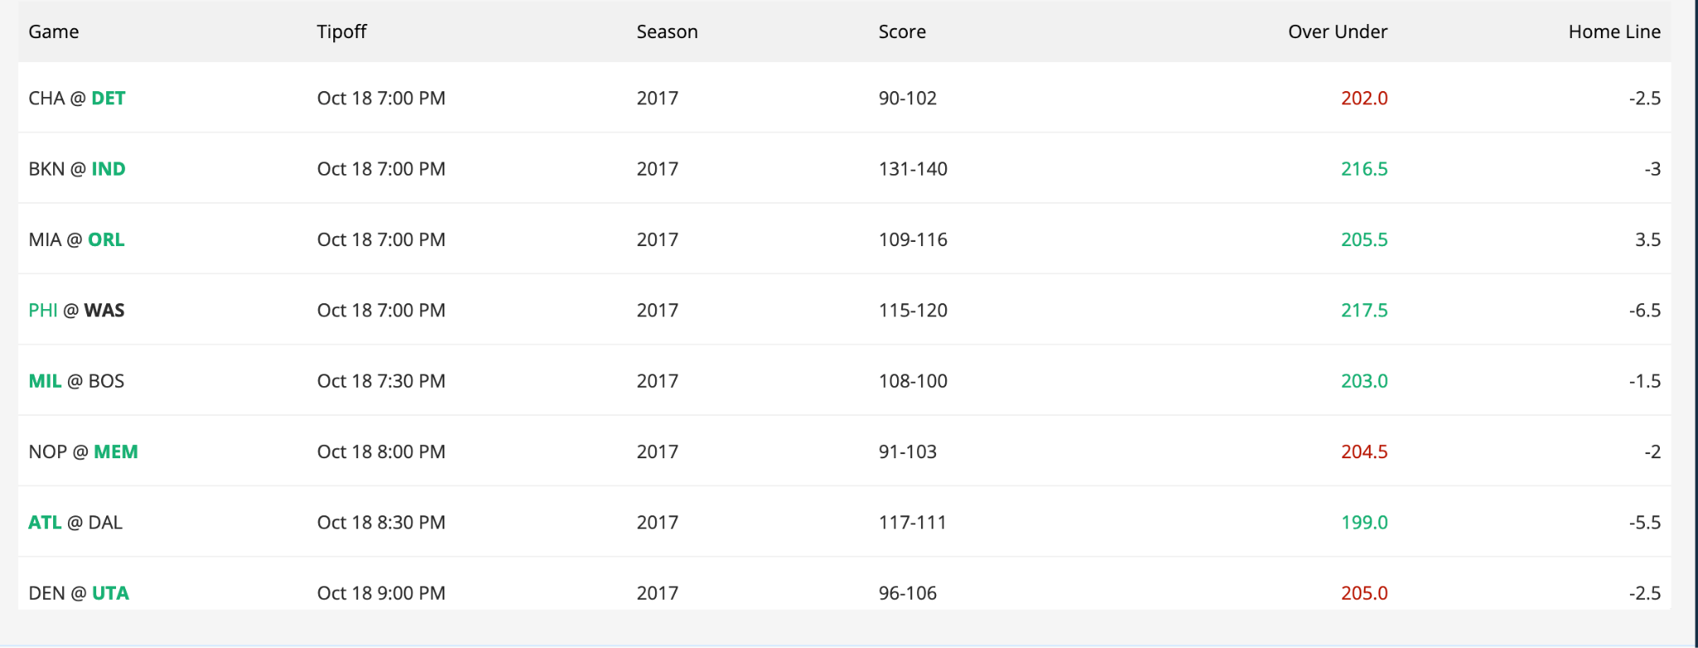
Web Scraping Betting Lines
Method
Used selenium to scrape https://www.rotowire.com/betting/nba/archive.php
Historical betting line data is locked behind a paywall from every other source
Scraping dynamic javascript tables was not a good time

Slide 11
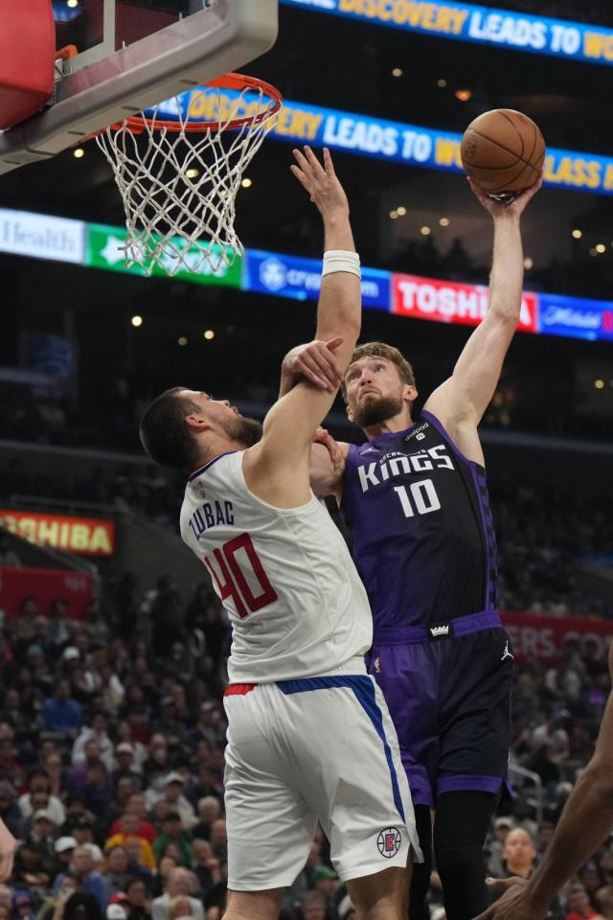
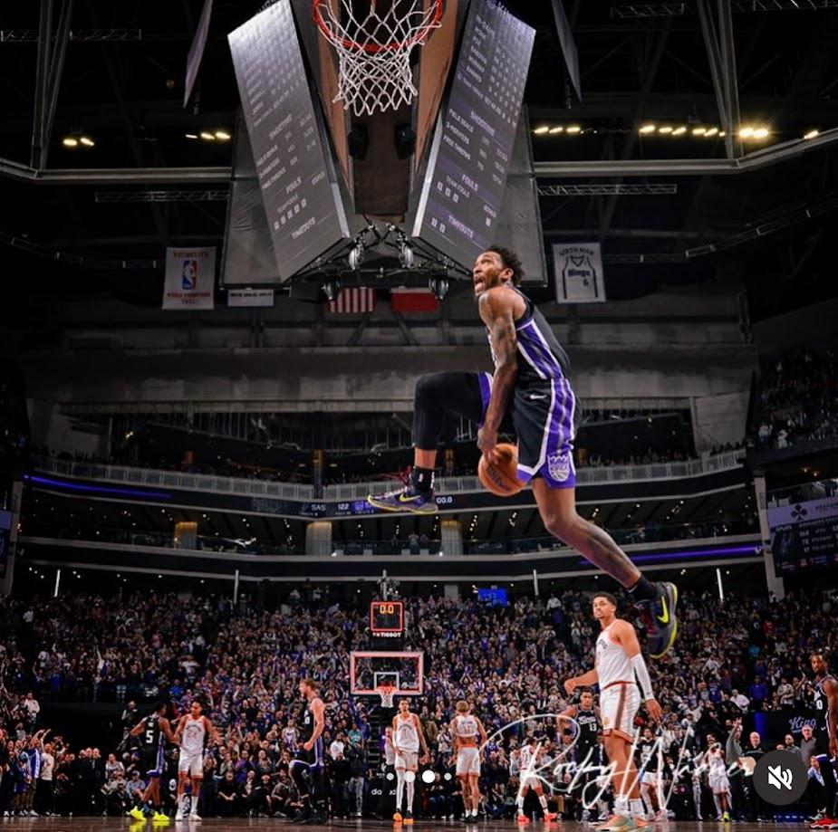
Next Steps
AWS
Issues:
NBA_API timeouts on AWS EC2 servers
Getting Data into AWS via other means
Steps:
Set up AWS Glue to collect data and store in S3
Automate collection and analysis pipeline using EC2
Set up to run every gameday
Betting Line Analysis
Steps:
Finish the betting line analysis for players birthdays
Run statistics to determine statistical significance of birthdays on teams performance with regard to the betting line
Get ip unbanned by the NBA_API…?

